Slide 1

KUBERNETES INTEGRATED MICROSERVICE DEVELOPMENT WITH ABP STUDIO
Halil İbrahim Kalkan Volosoft

Slide 2

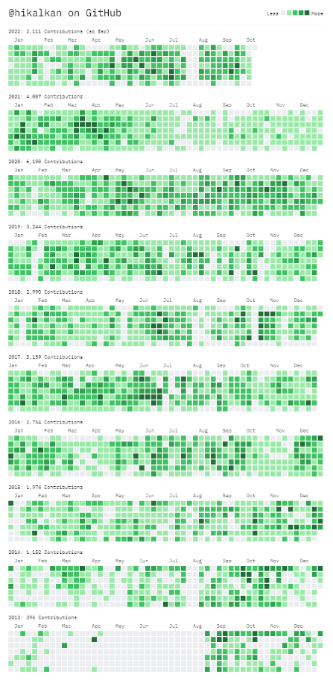






About Me: Halil İbrahim Kalkan
2007, Computer Engineering, Sakarya University
2007 - 2015: Software developer, software architect, team leader
2016 - ∞: Co-founder, software architect
2013 - ∞: Lead developer of the open source ABP Framework
Multi-threading, distributed systems, OOP, DDD, software architectures.. etc.
Highly active coder, mostly open source.

Slide 3
Agenda
Difficuties of a microservice development environment
The Project Tye (with demo)
ABP Studio: Solution Runner (with demo)
ABP Studio: Kubernetes Tunneling (with demo)

Slide 4
DIFFICULTIES OF A MICROSERVICE DEVELOPMENT ENVIRONMENT

Slide 5

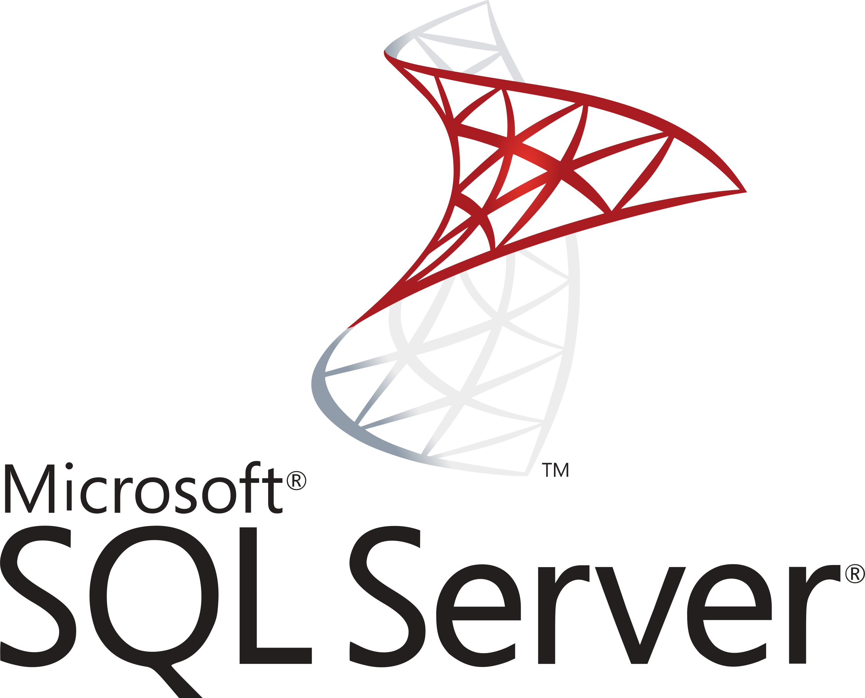





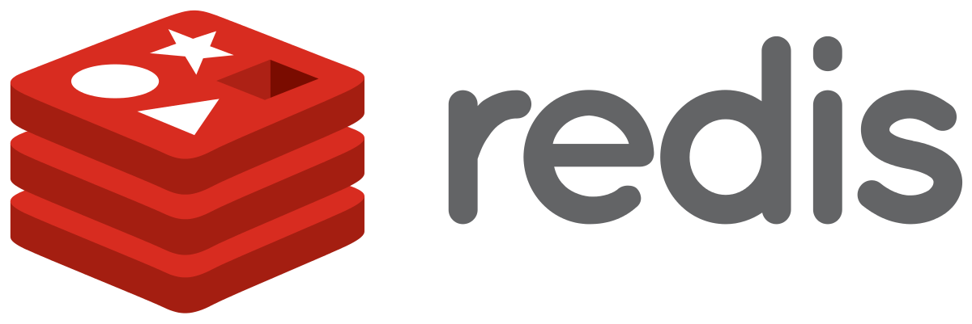


A Typical Microservice Solution
Authentication Server
Product Microservice
Backend Admin Application (SPA)
Backend App
API Gateway
Ordering Microservice
Event Bus
Public Web Site
(MVC)
Public Web Site
API Gateway
Identity Microservice
RabbitMQ
(Distributed Cache)
(Log Database)
(Data Visualization)

Slide 6
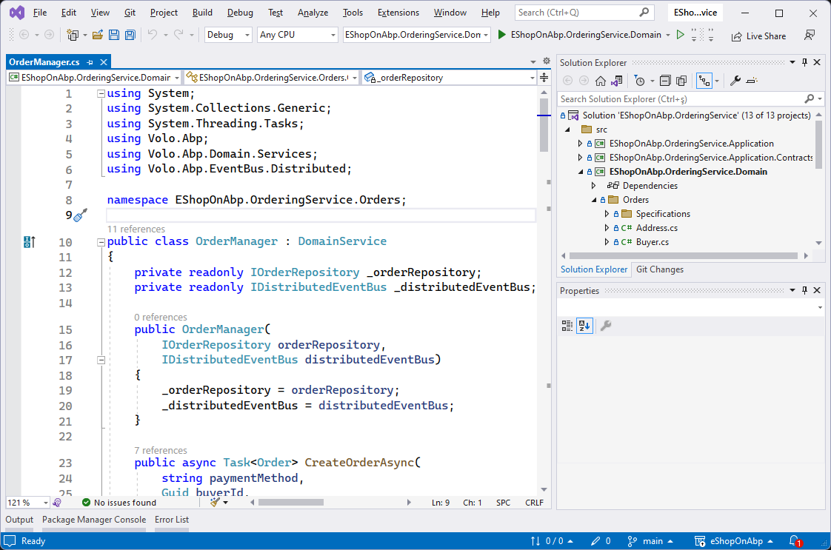
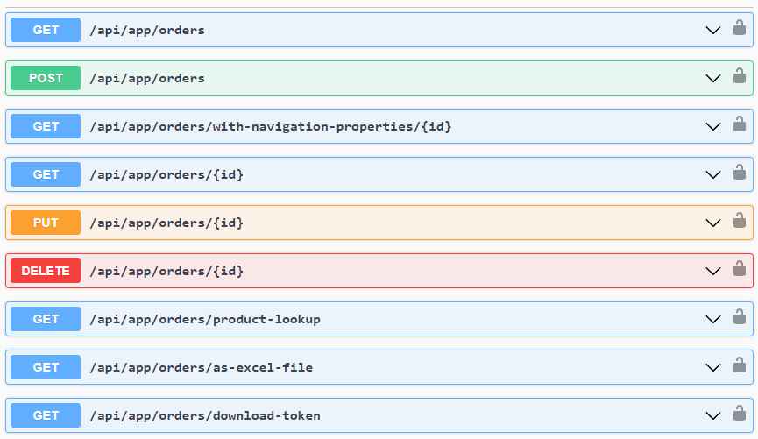
How to run a single service locally?
LOCAL DEVELOPER MACHINE
DEPENDENCIES
ORDERING SERVICE
Authentication Server
How to make all these running easily...?
Product Microservice
Customer Microservice
Saas Microservice
Identity Microservice
Run locally
...other services...

Slide 7
THE PROJECT TYE (by Microsoft)

Slide 8
The Project Tye (by Microsoft) https://github.com/dotnet/tye
«Tye is a tool that makes developing, testing, and deploying microservices and distributed applications easier.»
Tye Can:
Simplify microservices development by making it easy to:
Run many services with one command
Use dependencies in containers
Discover addresses of other services using simple conventions
Deploy .NET applications to Kubernetes by:
Automatically containerizing .NET applications
Generating Kubernetes manifests with minimal knowledge or configuration

Slide 9
Tye: Components
tye.yaml file
Tye CLI (Command-Line Interface)
Tye Dashboard

Slide 10
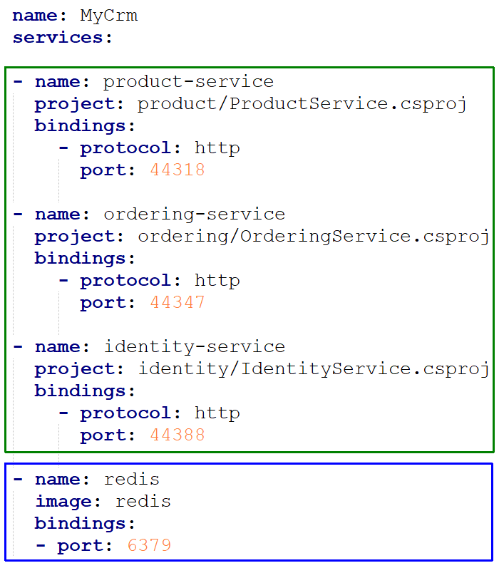
tye.yaml
.NET Projects
Service Types:
.NET Project
Container
Executable
Containers

Slide 11
Tye: CLI
> tye run --watch
other commands: init, build, push, deploy, undeploy

Slide 12
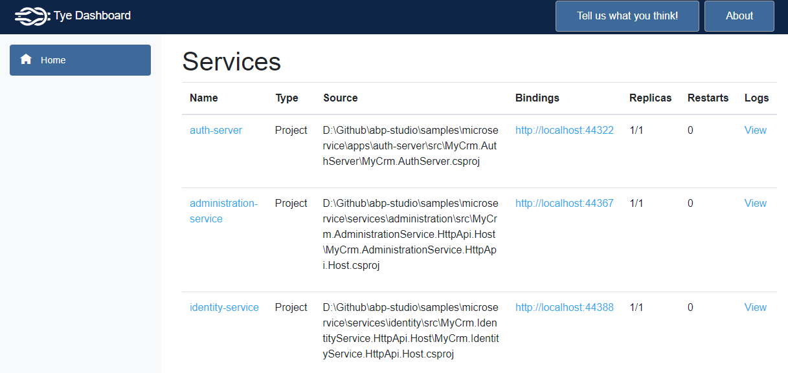
Tye: Dashboard http://localhost:8000

Slide 13
Demo: The Example Microservice Solution
Authentication Server
Product Microservice
Backend Admin Application (MVC)
Backend App
API Gateway
Ordering Microservice
Event Bus
Public Web Site
(MVC)
Public Web Site
API Gateway
Identity Microservice
RabbitMQ
(Distributed Cache)
(Log Database)
(Data Visualization)

Slide 14
Tye: Demo
DEMO..!

Slide 15
Tye: Shortcomings
Slow start (every time builds all): 60-70 seconds to run 10 services
Can only run all locally
Simple UI: No control on services
No way to stop / restart a single service manually (only stop all)
No information about internals of services
Lack of documentation

Slide 16
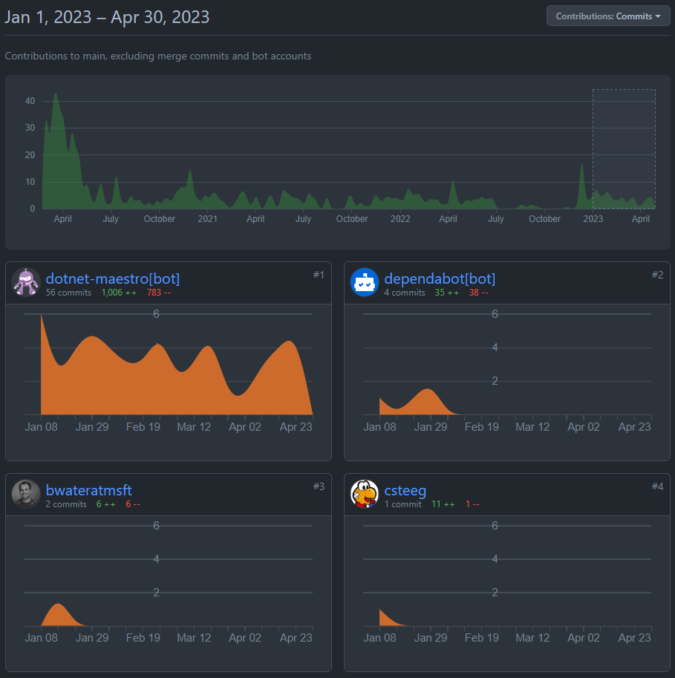
Tye: Shortcomings
No active development on GitHub

Slide 17
ABP STUDIO (by Volosoft)

Slide 18
What is ABP Studio?
An ABP-integrated desktop application for ABP developers.
Planned release date: Q3 of 2023.
Initial Features:
Create new solutions & modules
Install/uninstall modules
Explore your solution and used modules in a high-level view
Build monolith-modular and microservice solution structures easier
Run multi-application / microservice solutions easily
Kubernetes-integrated development environment

Slide 19

ABP Studio: Solution Runner
Initial Features:
Run a single, a group of or all services with a single-click
Overall view: See the running applications, incoming request and exception counts for each application.
HTTP Requests: See all the HTTP requests in the system as real-time, with all request and response details.
Exceptions: See exceptions in any service as real-time with the exception message and stacktrace, easily filter and search
Logs: Show and search in full logs of all applications
Browse: Browse the UI of any application with the built-in browser!

Slide 20
ABP Studio: Solution Runner
DEMO..!

Slide 21
Topic title
Content

Slide 22
Topic title
Content

Slide 23
Topic title
Content

Slide 24
Topic title
Content

Slide 25
Topic title
Content

Slide 26
Topic title
Content

Slide 27
Topic title
Content

Slide 28
Topic title
Content

Slide 29
Topic title
Content

Slide 30
Topic title
Content

Slide 31
Topic title
Content

Slide 32
Topic title
Content

Slide 33
Topic title
Content

Slide 34
Topic title
Content

Slide 35
Topic title
Content

Slide 36
Topic title
Content

Slide 37
Topic title
Content

Slide 38
Topic title
Content

Slide 39
Topic title
Content

Slide 40
Topic title
Content

